Slide 1



SHS
SMART HR SYSTEM
REZA HUSEN ANUGRAH
ANDI RAMLI HIDAYAT
DM2260932 - BF23 Power Window Assy
DM2260927- BF43 FRWP GP M&L Assy
Macros & Power Automate Developer
Microsoft List & Power Apps Developer
DX Project KOSEN #10

Slide 2














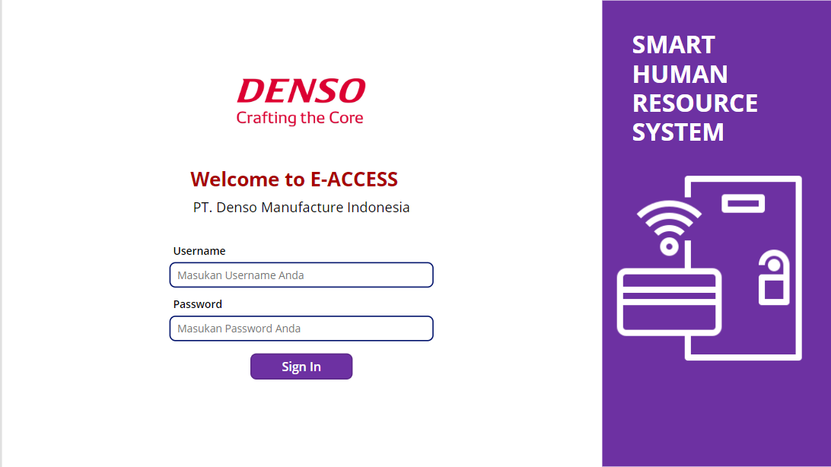


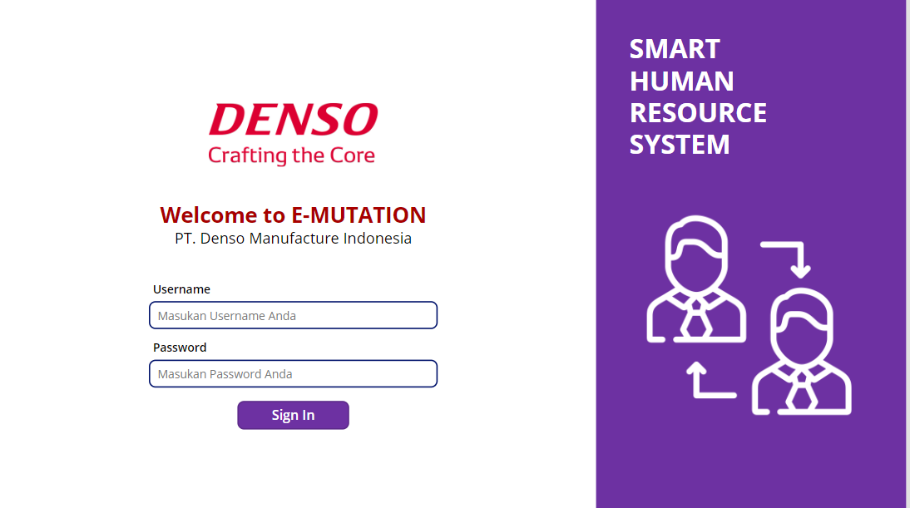




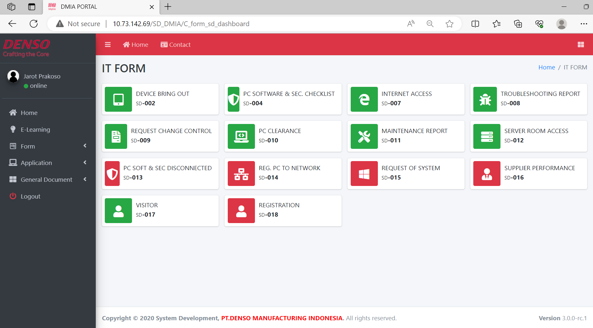






SHS
IMPROVE HR EFFICIENCY BY SMART SYSTEM
Smart HR System
Efficiency Operation with Digital System
SHS?
PURPOSE
TARGET
WAY OF
THINKING
Create Digitalize system to improve HR Efficiency.
Create Digital system that is easy to maintain
Create Visualization for Control and Tracked Form.
Reduce 74 paper / year , Reduce Cost Software Development 50 Million, Reduce Man Hour 15 Minutes.
Create Connection From Local To Power Platform
Create System using Power Platform
100 % Digital
Digitalize System at HR
GOALS
100%
One Stop
Service
How To Digitalize all Form
CURRENT CONDITION
Web Based ?
USER
Depends on Programmers for Create and Maintenance
ACTIVITY
USER
Power Platform ?
Create connection from local database to Power Platform
Spent 500 sheets of paper for Form.
Walking Time while approved step 10 minutes
Total time for 1 Form Cycle around 20 minutes.
Easy development and Maintenance for Non-Programmers
Cannot Connect Server Local
Create
E-Mutation Based Power Platform
Create
E-Access Based Power Platform
HR
Need Office 365 account
Difficult to Monitoring Employee Request
Approval flow is Not tracked
SMART HR SYSTEM
EASY DEVELOPMENT & MAINTAIN
STOP ADMIN SECTIONS JOBS
CONNECT TO LOCAL SERVER
Digital hybrid system technique
4 FORM digital
in HRSS
HR Pay Vendor to create and maintenance 4 form
POWER PLATFORM
WEB BASED
Development
Presentation
TIME
LINE
13 July – 02 Aug
01- 08 Aug
15 FORM
are still paper-based
Fast Digitalization
One Stop Service
1 MONTH
Detail Form
1 Digital form =
25 Million
Concept
User Accepted Test
All form In one Site
Easy Tracking Form Request
10-12 July
02 – 03 Aug
PT. DENSO MANUFACTURING INDONESIA
DIGITIZING SYSTEM IN AN EASY, FAST, AND CHEAP WAY
1/4
System Development
@ DENSO CORPORATION All Rights Reserved.

Slide 3
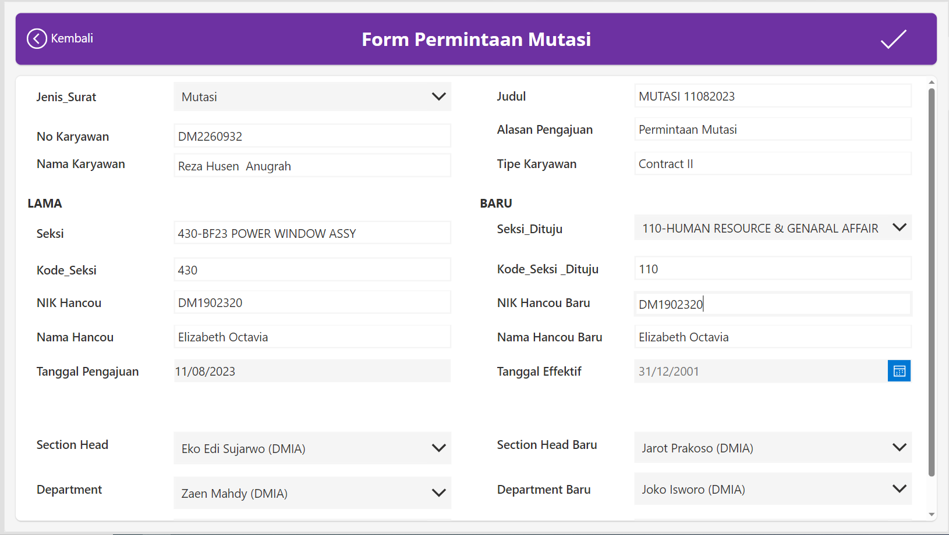

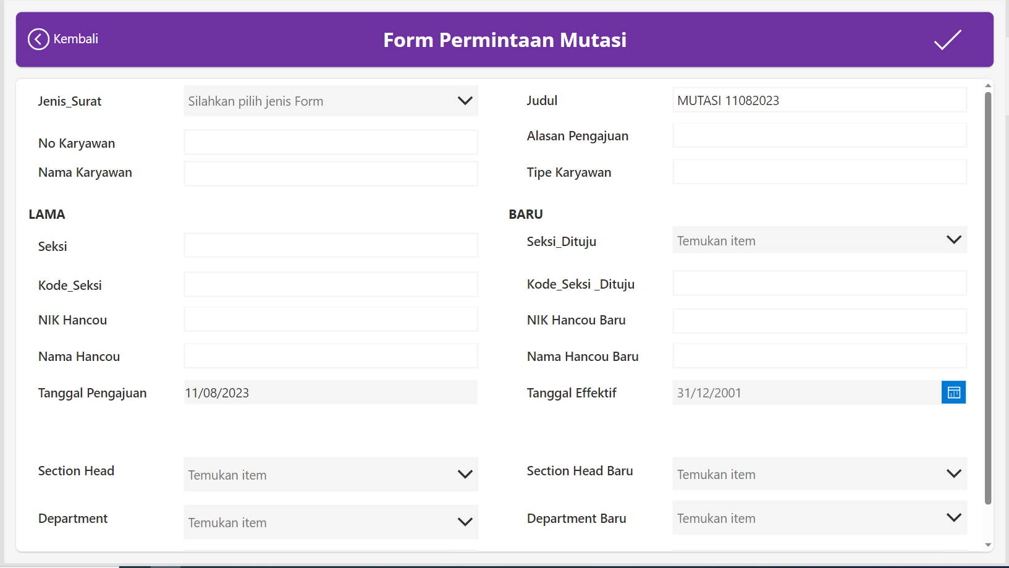
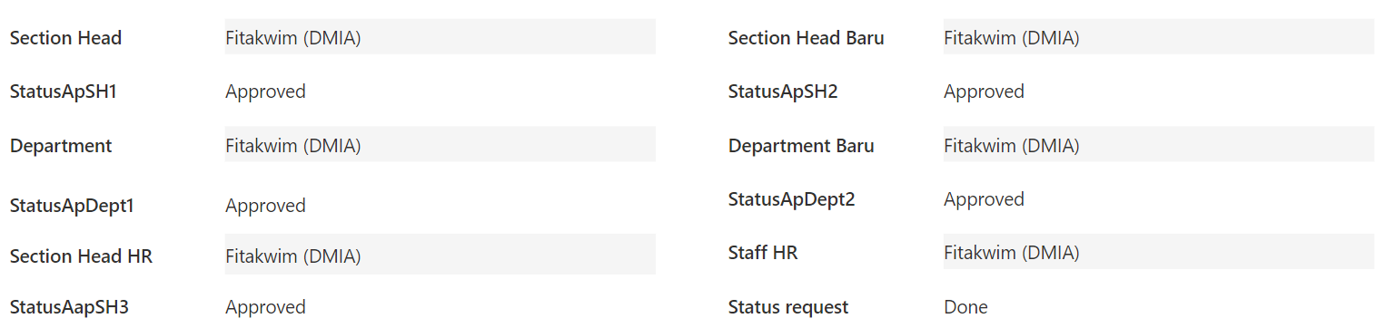




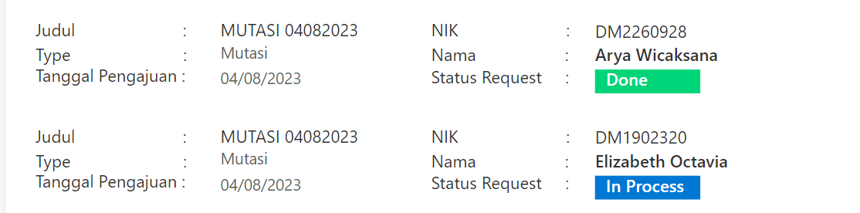


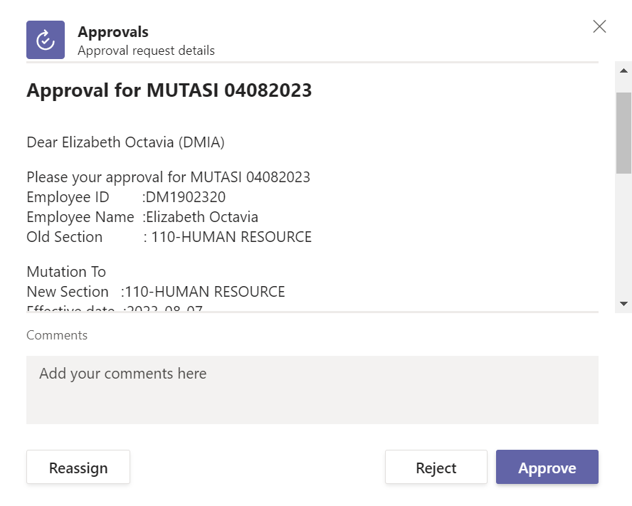

SHS
Smart HR System
DETAIL SYSTEM
DEVELOP CONNECTION
ADVANTAGES FORM
BEFORE
E-FORM BY POWER PLATFORM
x
All Data are stored on Local Server
User Need Data Employee for E-Form
Avoid inputting a lot of data manually
1. AUTO FILL INPUT FROM LOCAL DATA SERVER
?
WHY SHOULD CONNECT TO LOCAL SERVER
Cloud
Local Server
Speed up Input Form
Avoid error input
AFTER
Get query data from vendor
Limit 500 rows
Need Power Apps ID
Limit Output Value Power Automate
SYNC DATA
Cloud
Must be closed in order to access the data
Can access data in local server
No need Update Data
Get data for autofill input
Send Data to Database
2. TRACKED APPROVAL
Local Server
Must be open in order to access the data
User can know where the request form has been approved
Excel in Desktop
VBA Macros
FLOW PROCESS
FLOW PROCESS FORM
3. EASY CONTROL
PAPER FORM
DIGITAL FORM
Spent 500 Paper
Zero Paper Use
Admin can find out which form requests have ben processed and which have not
Input data on Device
Staff
Give to
Staff
Data sent
Admin HR
Input data Form on paper
Admin
( Section )
E-FORM
Process Data
4. STOP ADMIN SECTION JOB
Request Approval on Email
Give a
Form
Admin
(HR)
Approver
Request Approval
Approver
0 minutes Walking Time
No Need Admin section , The approval Process runs in system by email
Walking Time 10 minutes
Process Data
Paper Form can make Cost For Company
With Digital Form can Reduce Man Hour
& Paper Usage
PT. DENSO MANUFACTURING INDONESIA
DEVELOP EASY SYSTEM WITH NEW CONNCETION TECHNIQUE
2/4
System Development
@ DENSO CORPORATION All Rights Reserved.

Slide 4
SHS
Smart HR System
DETAIL SYSTEM
FLOW PROCESS FORM
FLOW PROCESS E-FORM
E-FORM BY POWER PLATFORM
Input data Form on paper
Input data on Device
AUTO FILL INPUT
Staff
Staff
Admin HR
Speed up Input Form
Avoid error input
Give to
Admin
( Section )
Data sent
Process Data
E-FORM
Request Approval on Email
Give a
Form
Admin
(HR)
Approver
Request Approval
Approver
Process Data
CURRENT CONNECTION
TRACKED APPROVAL
?
All Data are stored on Local Server
User Need Data Employee for E-Form
Limit column in cloud Storage
Avoid inputting a lot of data manually
x
WHY SHOULD CONNECT TO LOCAL SERVER
User can know where the request form has been approved
Must Pay License
Local Server
Cloud
DEVELOP CONNECTION TECHNIQUE
EASY CONTROL
Get query data from vendor
Admin can find out which form requests have ben processed and which have not
Limit 500 rows
Need Power Apps ID
Limit Output Value Power Automate
SYNC DATA
Cloud
Can access data in local server
No need Update Data
Get data for autofill input
Send Data to Database
Must be closed in order to access the data
Local Server
STOP ADMIN SECTION JOB
Must be open in order to access the data
No Need Admin section , The approval Process runs in system by email
Excel in Desktop
VBA Macros
PT. DENSO MANUFACTURING INDONESIA
DEVELOP EASY SYSTEM WITH NEW CONNCETION TECHNIQUE
2/4
System Development
@ DENSO CORPORATION All Rights Reserved.

Slide 5
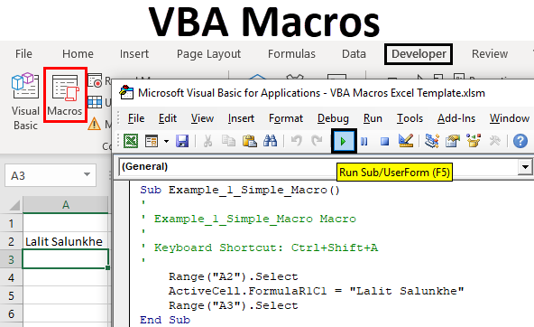

SHS
Smart HR System
RESULT
IMPLEMENTATION
ACTUAL BENEFIT
1
Reduce Paper Usage
2
Reduce Cost Software Development
Pays vendor 25 million for 1 one application
2 form x 25 million = 50 million
Connection
DONE
0Rp
Create 2 Forms Costs
=
Saving Money 50 million
PAPER FORM
DIGITAL FORM
2 Form have been Digitalize
= 74 paper / year
E-Mutation
DONE
3
Reduce Man Hours
BEFORE E-FORM
Preparing the paper form
5 minutes
Fill Form by writing
3 minutes
Admin go to approver
10 minutes.
18 minutes
Reduce man hours 15 minutes
E-Access
AFTER
E-FORM
Preparing
E- form
2 minutes.
AutoFill Form
system
1 minutes.
System Approval by email
DONE
3 minutes
PT. DENSO MANUFACTURING INDONESIA
3/4
System Development
REDUCE PAPER, COST & MAN HOURS
@ DENSO CORPORATION All Rights Reserved.

Slide 6





SHS
Smart HR System
LEARNING POINT
SKILLS MATRIX
THE NEXT PLANNING FOR SMART HR SYSTEM
As we learn new knowledge, we will plan our next move to digitalize all forms
Employee With 365 Account
Employee Without 365 Account
POWER PLATFORM
WEB BASE
ID Card Replacement Form
Permit Work Leave Form
Holiday Work Request Form
Day Change Request Form
Work Permit Outside Form
Independent transportation allowance registration form
Salary Correction Form
Document Request Form
Absence Statement Without Explanation Form
Training Report Form
Own Motor Vehicle Form
Claims For Official Travel Expenses by Private Vehicle
Registration Of Independent Transportation Allowance Form
LEARNING OBTAINED
Dare to try new Things
Current Analysis + PDCA is must to make a proper planning and targets before do something.
Always think positively and believe that we can break our limits.
Always Communicate to report and discussion at every step.
Specification Analysis is Key
One Stop Smart HR System
PT. DENSO MANUFACTURING INDONESIA
4/4
System Development
LEARN SOMETHING NEW TO IMPORVE SKILL
@ DENSO CORPORATION All Rights Reserved.

Slide 7
SHS
Smart HR System
HR FORM
BACK
15 FORM
are still paper-based
4 FORM digital
in HRSS
Mutation Form
Office Access Form
Independent transportation allowance registration form
Salary Correction Form
ID Card Replacement Form
Document Request Form
Permit Work Leave Form
Absence Statement Without Explanation Form
Holiday Work Request Form
Day Change Request Form
Training Report Form
Work Permit Outside Form
Own Motor Vehicle Form
Claims For Official Travel Expenses by Private Vehicle
Registration Of Independent Transportation Allowance Form
Form Overtime Request
Form MBO
Form Manpower Request
Form Appraisal
PT. DENSO MANUFACTURING INDONESIA
System Development
@ DENSO CORPORATION All Rights Reserved.

Slide 8





SHS
IMPROVE HR EFFICIENCY BY SMART SYSTEM
Smart HR System
How To Digitize all Form ?
PURPOSE
Efficiency Operation with Digital System
SHS?
WAY OF
THINKING
Vendor ?
Digitalize system to improve HR Efficiency,
Paper Less, Reduce costs & man hour.
100 % Digital
Should pay a lot of money
Digitalize System at HR
Web Based ?
Digitalize without vendor to start a citizen developer for reduce cost.
GOALS
100%
One Stop
Service
Depend to Programmers for Create and Maintenance
15 Apps x 25 million = 375 million
Power Platform ?
Create visualization for Control and Tracked Form
CURRENT CONDITION
Easy development, Maintenance for Non-Programmers and Cheap
USER
Cannot Connect Server Local
TARGET
Need Office 365 account
Digitized 15 paper forms to E-forms
Create a system using the power platform to raise spirits the Citizen Developer
Spent 500 sheets of paper for Form.
Walking Time while approved step 10 minutes
Total time required around 20 minutes.
SMART HR SYSTEM
Digital hybrid system technique
POWER PLATFORM
WEB BASED
ACTIVITY
HR
Difficult to Monitoring Employee Request
Approval flow is Not tracked
Create connection from local database to Power Platform
4 FORM digital
in HRSS
HR Pay Vendor to digitalize 4 form
Speed Up Digitalization
One Stop Service
Easy To Monitoring Form Request
Create
E-Mutation Based Power Platform
Create
E-Access Based Power Platform
1 app = 25 Million
Development
Presentation
15 FORM
are still paper-based
TIME
LINE
13 July – 02 Aug
01- 08 Aug
EASY DEVELOPMENT
STOP ADMIN SECTIONS JOBS
CONNECT TO LOCAL SERVER
Detail Form
1 MONTH
Concept
User Accepted Test
10-12 July
02 – 03 Aug
PT. DENSO MANUFACTURING INDONESIA
DIGITIZING SYSTEM IN AN EASY, FAST, AND CHEAP WAY
1/4
System Development
@ DENSO CORPORATION All Rights Reserved.

